Slide 1
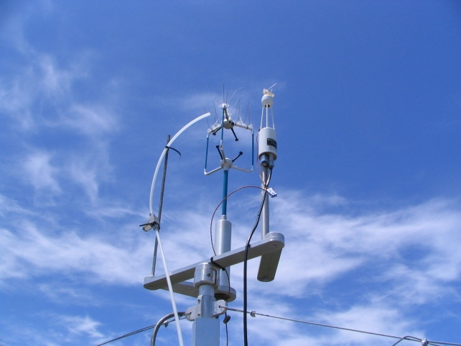
Micrometeorological Methods Used to Measure Greenhouse Gas Fluxes:
The Challenges Associated with Them, at the Local to Global Scales
Dennis Baldocchi
University of California, Berkeley
JASON GHG Emissions Monitoring
Summer Study (June 16-18, 2010)
La Jolla, CA

Slide 2

Methods To Assess Terrestrial Carbon Budgets at Landscape to Continental Scales, and Across Multiple Time Scales
GCM Inversion
Modeling
Eddy Flux
Measurements/
FLUXNET
Remote Sensing/
MODIS
Forest/Biomass
Inventories
Physiological Measurements/
Manipulation Expts.
Biogeochemical/
Ecosystem Dynamics
Modeling

Slide 3
From point to globe via integration with remote sensing
(and gridded metorology)
century
forest
inventory
plot
Forest/soil inventories
decade
Landsurface remote sensing
Eddy
covariance
towers
tall
tower
obser-
vatories
year
remote sensing
of CO₂
Temporal scale
month
week
day
hour
local 0.1 1 10 100 1000 10 000 global
plot/site
Countries
EU
Spatial scale [km]
From: Markus Reichstein, MPI
Notes:
Look at what we have: observations. Only they provide the door to the real world. They should provide the backbone of the research.
To paraphrase the Philosopher Imanuel Kant, “models without data are empty, and data without models are blind.”
Eddy + forest
Remote sensing of veg
Remote stat + tall
Remote sensing CO2 (dünn, label ausserhalb)

Slide 4
Challenges in Measuring Greenhouse Gas Fluxes
Measuring/Interpreting greenhouse gas flux in a quasi-continuous manner for days, years and decades
Measuring/Interpreting fluxes over Patchy, Microbially-mediated Sources (e.g. CH₄, N₂O)
Measuring/Interpreting fluxes of Temporally Intermittent Sources (CH₄, N₂O, O₃, C₅H₈)
Measuring/Interpreting fluxes over Complex Terrain
Developing New Sensors for Routine Application of Eddy Covariance, or Micrometeorological Theory, for trace gas Flux measurements and their isotopes (CH₄, N₂O,¹³CO₂, C¹⁸O₂)
Measuring fluxes of greenhouse gases in Remote Areas without ac line power

Slide 5
Flux Methods Appropriate for Slower Sensors, e.g. FTIR
Relaxed Eddy Accumulation
Modified Gradient Approach
Integrated Profile
Disjunct Sampling

Slide 6
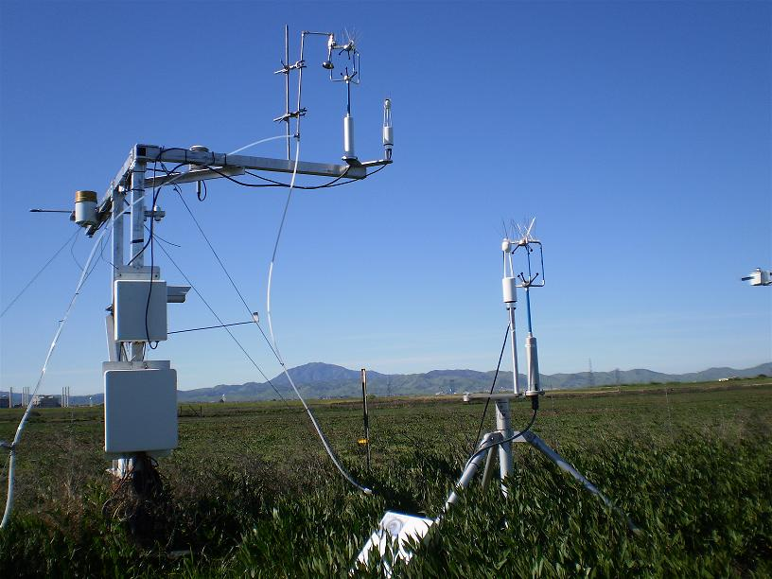
Eddy Covariance
Direct Measure of the Trace Gas Flux Density between the atmosphere and biosphere, mole m⁻² s⁻¹
Introduces No Sampling artifacts, like chambers
Quasi-continuous
Integrative of a Broad Area, 100s m²
In situ

Slide 7
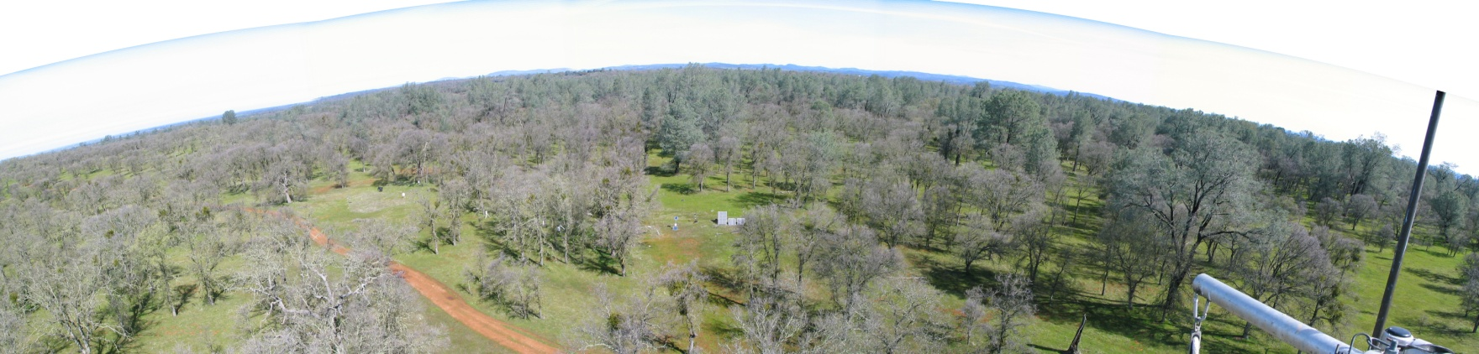
Eddy Covariance,
Flux Density: mol m⁻² s⁻¹ or J m⁻² s⁻¹

Slide 8
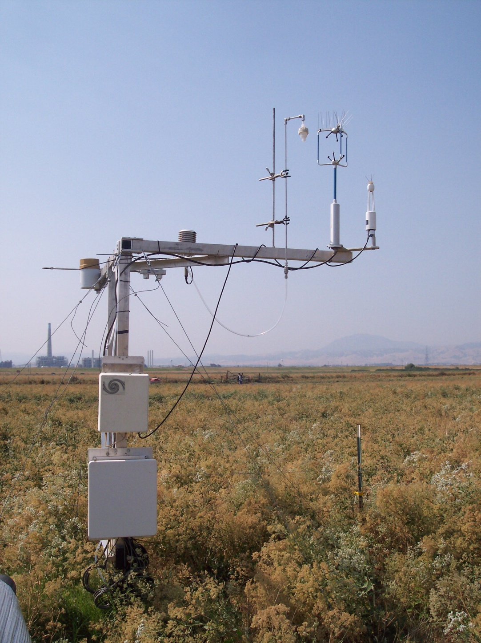
Eddy Covariance Tower
Sonic Anemometer, CO2/H2O IRGA,
inlet for CH4 Tunable diode laser spectrometer &
Meteorological Sensors

Slide 9
24 Hour Time Series of 10 Hz Data,
Vertical Velocity (w) and Methane (CH₄) Concentration
D164, 2008
Sherman Island, CA: data of Detto and Baldocchi

Slide 10
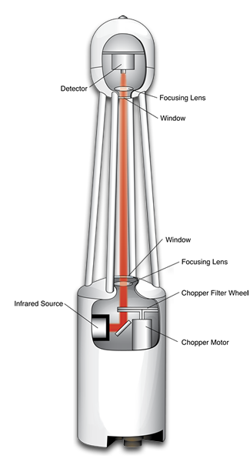
Non-Dispersive Infrared Spectrometer, CO₂ and H₂O
Open-path , 12.5 cm
Low Power, 10 W
Low noise, CO₂: 0.16 ppm; H₂O: 0.0047 ppth
Low drift, stable calibration
Low temperature sensitivity: 0.02%/degree C
LI 7500

Slide 11
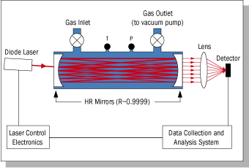
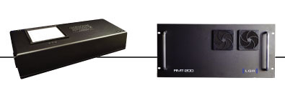
Measuring Methane with Off-Axis Infrared Laser Spectrometer
Closed path
Moderate Cell Volume, 400 cc
Long path length, kilometers
High power Use:
Sensor, 80 W
Pump, 1000 W; 30-50 lpm
Low noise: 1 ppb at 1 Hz
Stable Calibration
Los Gatos Research

Slide 12
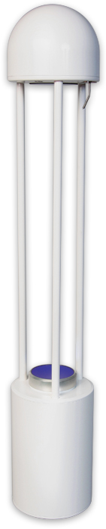
LI-7700 Methane Sensor,
variant of frequency modulation spectroscopy
Open path, 0.5 m
Short optical path length, 30 m
Low Power Use: 8 W, no pump
Moderate Noise: 5 ppb at 10 Hz
Stable Calibration

Slide 13
Power Spectrum defines the Frequencies to be Sampled
Power Spectrum
Co-Spectrum

Slide 14
Signal Attenuation:
The Role of Filtering Functions and Spectra
High and Low-pass filtering via Mean Removal
  Sampling Rate (1-10Hz) and Averaging Duration (30-60 min)
Digital sampling and Aliasing
Sensor response time
Sensor Attenuation of signal
  Tubing length and Volumetric Flow Rate
  Sensor Line or Volume averaging
Sensor separation
  Lag and Lead times between w and c

Slide 15
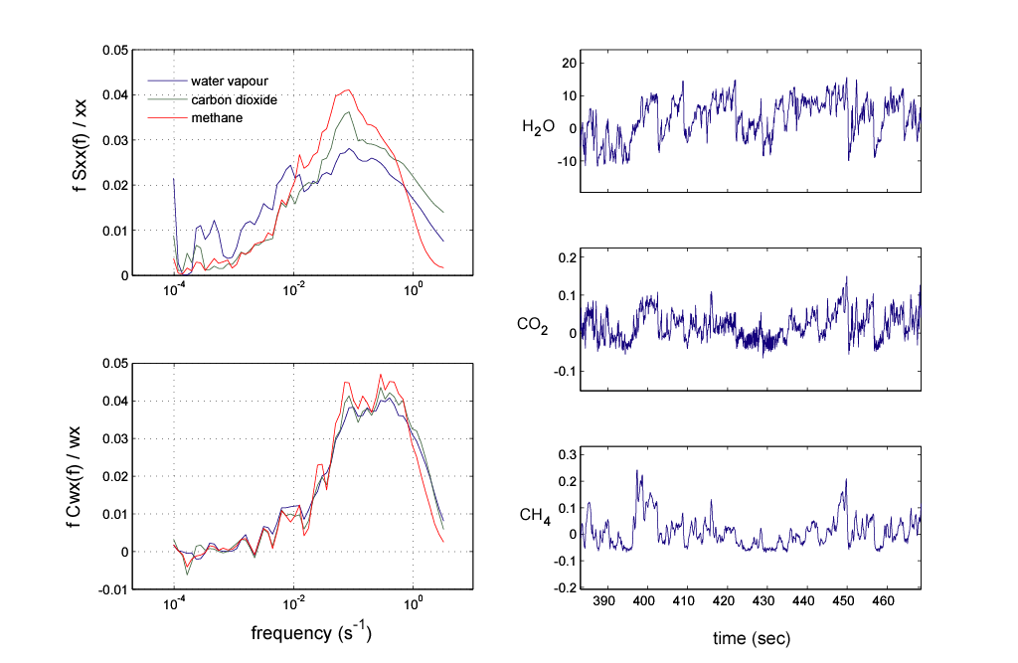
Comparing Co-spectra of open-path CO2 & H2O sensor and closed-path CH4 sensor
Co-Spectra are More Forgiving of Inadequate Sensor Performance than Power Spectra
Because there is little w-c correlation in the inertial subrange
M.Detto and D. Baldocchi

Slide 16
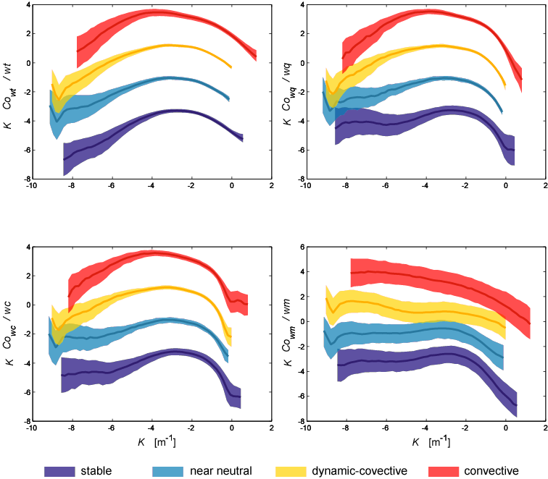
Co-Spectra is a Function of Atmospheric Stability:
Shifts to Shorter Wavelengths under Stable Conditions
Shifts to Longer Wavelengths under Unstable Conditions
Detto, Baldocchi and Katul, Boundary Layer Meteorology, accepted

Slide 17
Zero-Flux Detection Limit, Detecting Signal from Noise
r_{wc} ~ 0.5
σ_{ch4} ~ 0.84 ppb
σ_{co2} ~ 0.11 ppm
U* | σ_{w} | F_{min,} CH4 | F_{min,} CO2
m/s | m/s | nmol m⁻² s⁻¹ | μmol m⁻² s⁻¹
0.1 | 0.125 | 2.1 | 0.275
0.2 | 0.25 | 4.2 | 0.55
0.3 | 0.375 | 6.3 | 0.825
0.4 | 0.5 | 8.4 | 1.1
0.5 | 0.625 | 10.5 | 1.375
Notes:
Over confident…Look at noise with shorter and shorter sampling Frequencies

Slide 18
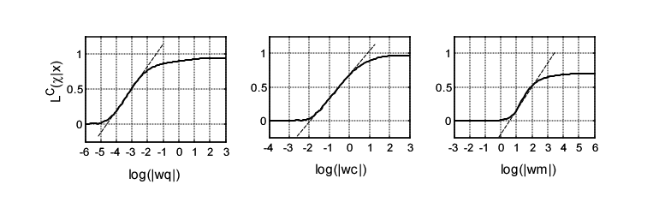
Flux Detection Limit, v2
Based on 95% CI that the Correlation between
W and C that is non-zero
0.035 mmol m⁻² s⁻¹, 0.31 μmol m⁻² s⁻¹ and 3.78 nmol m⁻² s⁻¹ for water vapour, carbon dioxide and methane flux,
Detto et al, in prep

Slide 19
Most Sensors Measure Mole Density, Not Mixing Ratio
Formal Definition of Eddy Covariance, V2

Slide 20
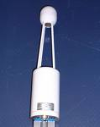
Webb, Pearman, Leuning Algorithm:
‘Correction’ for Density Fluctuations when using Open-Path Sensors

Slide 21
Raw <w’c’> signal, without density ‘corrections’,
will infer Carbon Uptake when the system is Dead and Respiring

Slide 22
Density ‘Corrections’ Are More Severe for CH₄ and N₂O:
This Imposes a Need for Accurate and Concurrent Flux Measurements of H and LE

Slide 23
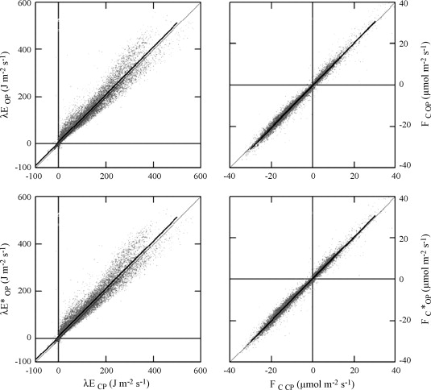
Annual Time Scale, Open vs Closed sensors
Hanslwanter et al 2009 AgForMet
Notes:
6 years of data

Slide 24
Towards Annual Sums
Accounting for Systematic and Random Bias Errors
Advection/Flux Divergence
U* correction for lack of adequate turbulent mixing at night
QA/QC for Improper Sensor Performance
  Calibration drift (slope and intercept), spikes/noise, a/d off-range
  Signal Filtering
Software Processing Errors
Lack of Fetch/Spatial Biases
  Sorting by Appropriate Flux Footprint
Change in Storage
Gaps and Gap-Filling

Slide 25
Systematic and Random Errors

Slide 26
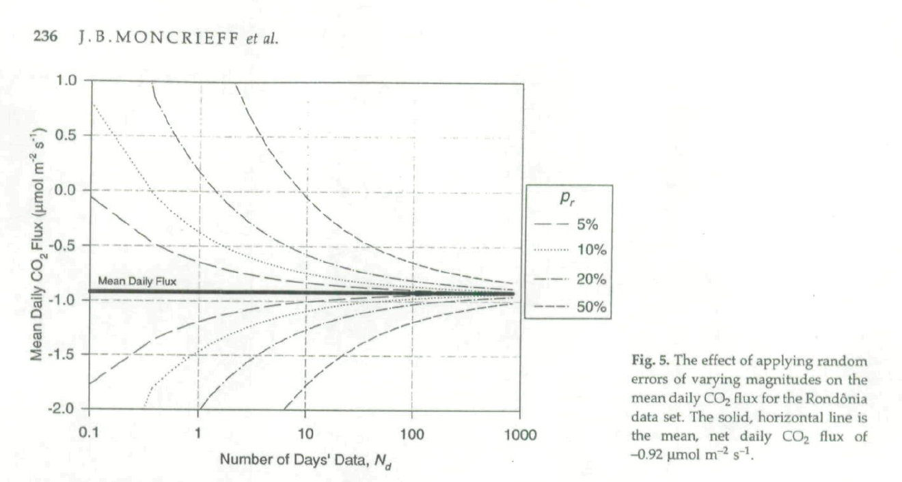
Random Errors Diminish as We Measure Fluxes Annually
and Increase the Sample Size, n

Slide 27
Tall Vegetation, Undulating Terrain
Short Vegetation, Flat Terrain

Slide 28

Systematic Biases and Flux Resolution:
A Perspective
F_{CO2}: +/- 0.3 μmol m⁻² s⁻¹ => +/- 113 gC m⁻² y⁻¹
1 sheet of Computer paper 1 m by 1 m: ~70 gC m⁻² y⁻¹
Net Global Land Source/Sink of 1PgC (10¹⁵g y⁻¹): 6.7 gC m⁻² y⁻¹

Slide 29
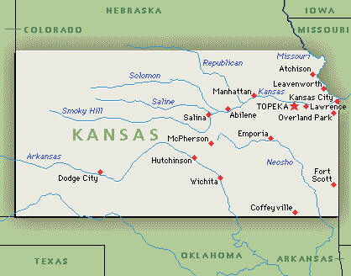
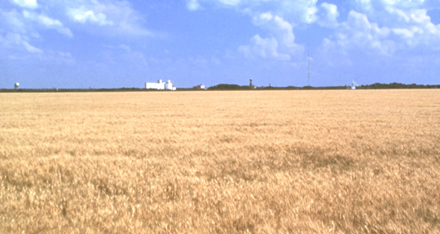

The Real World is Not Kansas, which is Flatter than a Pancake

Slide 30
Eddy Covariance in the Real World

Slide 31
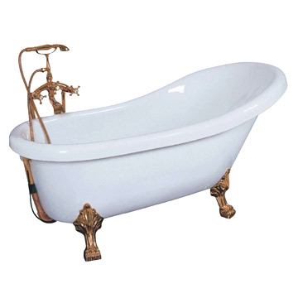
Diagnosis of the Conservation Equation for C for Turbulent Flow
I
II
III
I: Time Rate of Change
II: Advection
III: Flux Divergence

Slide 32
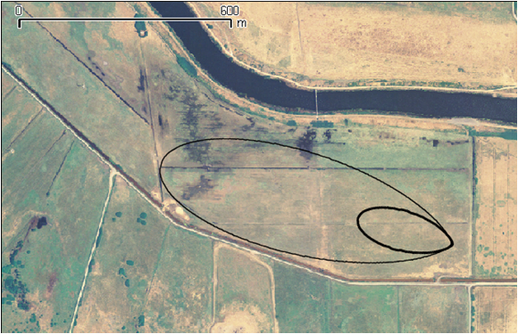
Daytime and Nightime Footprints over an Ideal, Flat Paddock
Detto et al. Boundary Layer Meteorology, conditionally accepted

Slide 33
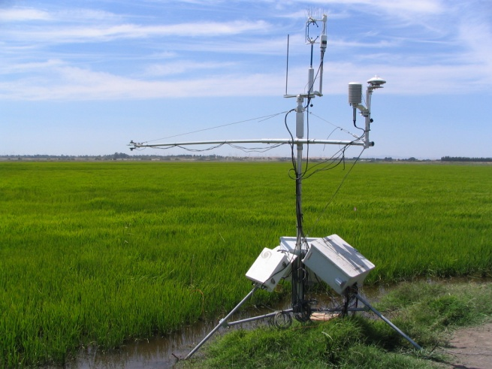
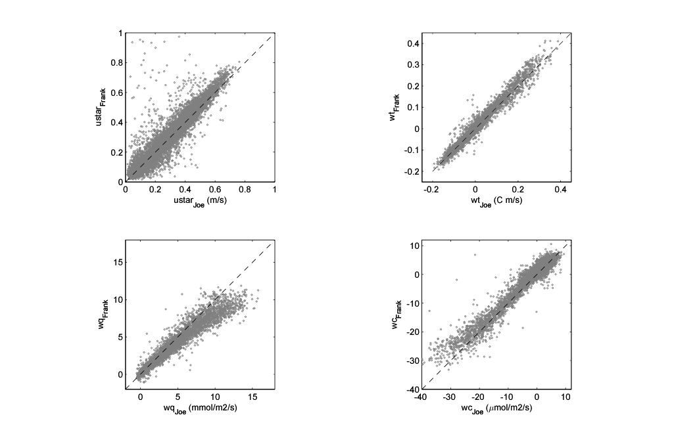
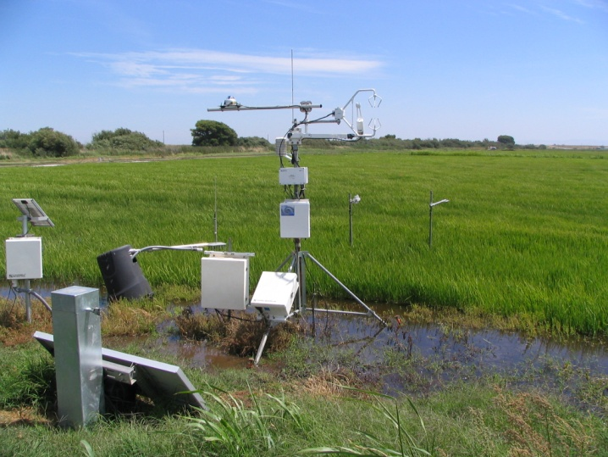
Estimating Flux Uncertainties:
Two Towers over Rice
Detto, Anderson, Verfaillie, Baldocchi, unpublished

Slide 34
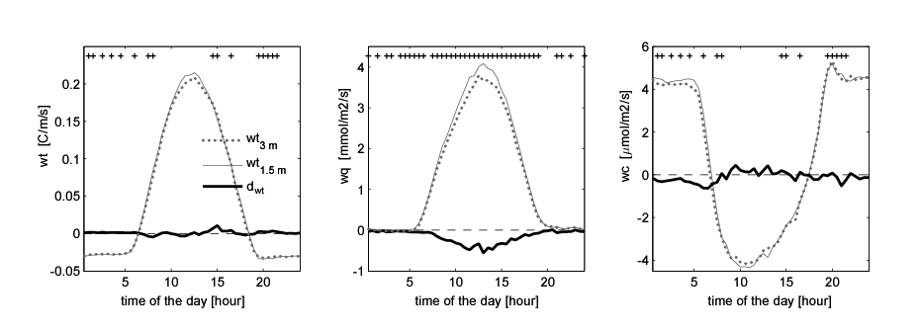
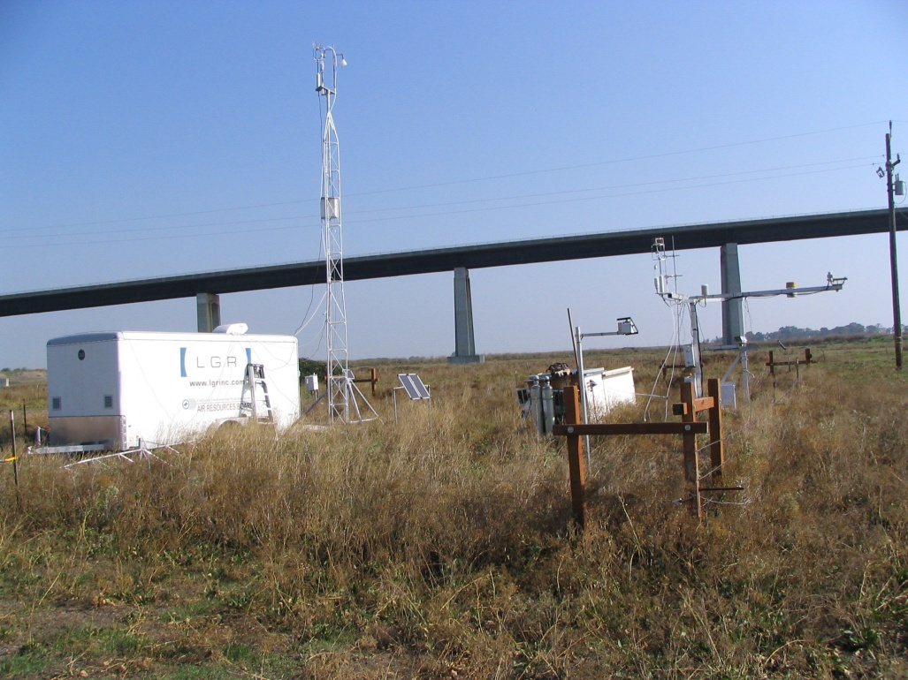
Examine Flux Divergence
Detto, Baldocchi and Katul,
Boundary Layer Meteorology, conditionally accepted

Slide 35
Underestimating C efflux at Night, Under Tall Forests, in Undulating Terrain
Baldocchi et al., 2000 BLM

Slide 36
Losses of CO₂ Flux at Night: u* correction
Notes:
Discuss Pros and Cons of u* correction

Slide 37
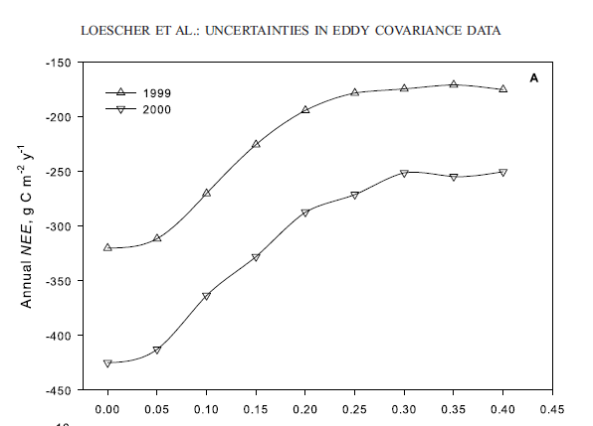
Systematic Biases are an Artifact of Low Nocturnal Wind Velocity
Friction Velocity, m/s

Slide 38
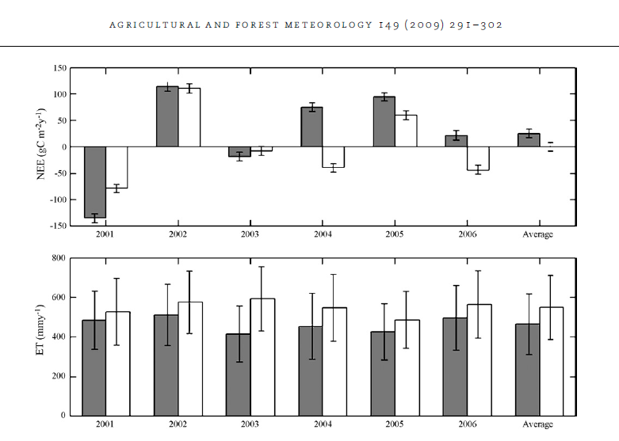
Annual Sums comparing Open and Closed Path Irgas
Hanslwanter et al 2009 AgForMet

Slide 39
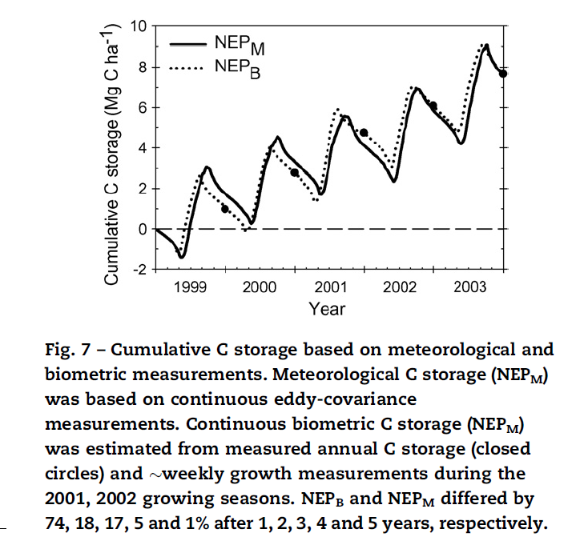
Biometric and Eddy Covariance C Balances Converge after Multiple Years
Gough et al. 2008, AgForMet

Slide 40
Contrary Evidence from Personal Experience:
Crops, Grasslands and Forests

Slide 41
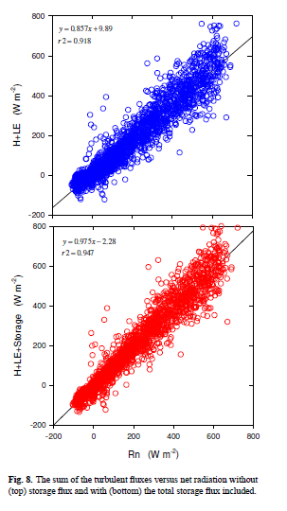
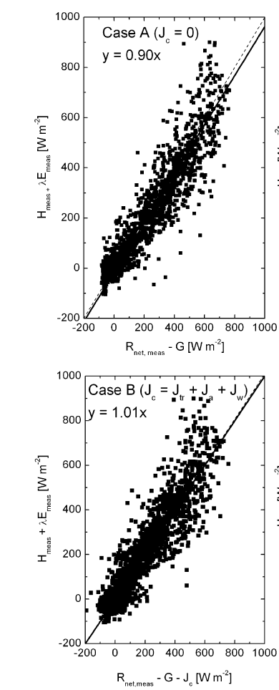
Many Studies Don’t Consider Heat Storage
of Forests Well, or at All, and Close Energy Balance when they Do
Lindroth et al 2010 Biogeoscience
Haverd et al 2007 AgForMet

Slide 42
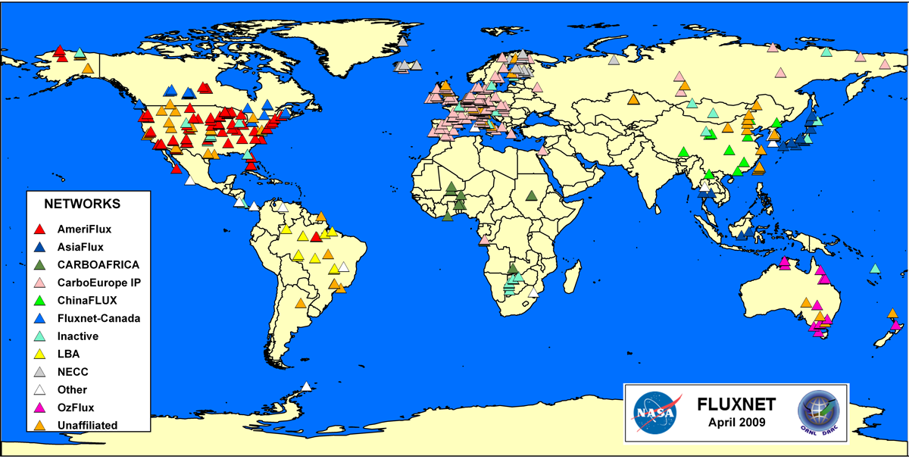
FLUXNET: From Sea to Shining Sea
500+ Sites, circa 2009

Slide 43
Limits and Criteria for Network Design for Treaty Verification
Can We Statistically-Sample or Augment Regional, Continental and Global Scale C Budgets with a Sparse Network of Flux Towers?
If Yes:
  How Many Towers are Enough?
  Where Should the Towers Be?
  How Good is Good Enough with regards to Fluxes?
  How Long Should We Collect Data?

Slide 44
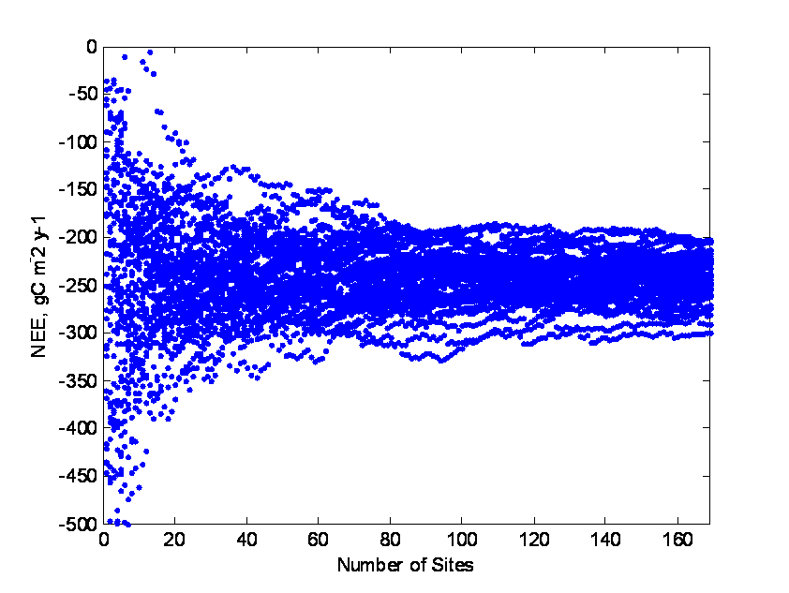
How many Towers are needed to estimate mean NEE, GPP
and assess Interannual Variability, at the Global Scale?
Green Plants Abhor a Vacuum, Most Use C₃ Photosynthesis,
so we May Not need to be Everywhere, All of the Time
We Need about 75 towers to produce Robust and Invariant Statistics

Slide 45
Probability Distribution of Published NEE Measurements, Integrated Annually
Baldocchi, Austral J Botany, 2008

Slide 46
Interannual Variability of the Statistics of NEE is Small across a sub-network of 75 Sites
Mean NEE Ranges between -220 to -243 gC m⁻² y⁻¹
Standard Deviation Ranges between 35.2 and 39.9 gC m⁻² y⁻¹

Slide 47
Interannual Variability in GPP is small, too,
across the Global Network (1103 to 1162 gC m⁻² y⁻¹)
Assuming Global Arable Land area is 110 10⁶ km²,
Mean Global GPP ranges between 121.3 and 127.8 PgC/y
Precision is about +/- 7 PgC/y

Slide 48
Ecosystem Respiration Scales Tightly with Ecosystem Photosynthesis,
But Is with Offset by Disturbance
Baldocchi, Austral J Botany 2008

Slide 49
Net Carbon Exchange is a Function of Time Since Disturbance
Baldocchi, Austral J Botany, 2008

Slide 50
C Fluxes May Vary Interannual on 7 to 10 year Time Scales

Slide 51
Upscale NEP, Globally, Explicitly
Compute GPP = f(T, ppt)
Compute R_{eco} = f(GPP, Disturbance)
Compute NEP = GPP-R_{eco}
Leith-Reichstein Model
FLUXNET Synthesis
Baldocchi, 2008, Aust J Botany
R_{eco} = 101 + 0.7468 * GPP
R_{eco}, disturbed= 434.99 + 0.922 * GPP

Slide 52
<NEE> = -222 gC m⁻² y⁻¹
This Flux Density Matches FLUXNET (-225) well, but Σ NEE = -31 PgC/y!!
Implies too Large NEE (|-700 gC m⁻² y⁻¹| Fluxes in Tropics
Ignores C losses from Disturbance and Land Use Change
Notes:
Σ NEE = -31 PgC/y

Slide 53
Explicit Climate-Based Upscaling
Under Represents Disturbance Effects
FLUXNET Under
Samples Tropics
Statistically Sampling and Climate Upscaling Agree
<NEE: FLUXNET> = -225 +/- 164 gC m-2 y-1
<NEE 0% dist: sinusoidal> = -222 gC m-2 y-1

Slide 54
To Balance Carbon Fluxes infers that Disturbance Effects May Be Greater than Presumed
<NEE> = -4.5 gC m⁻² y⁻¹
Σ NEE = -1.58 PgC/y

Slide 55
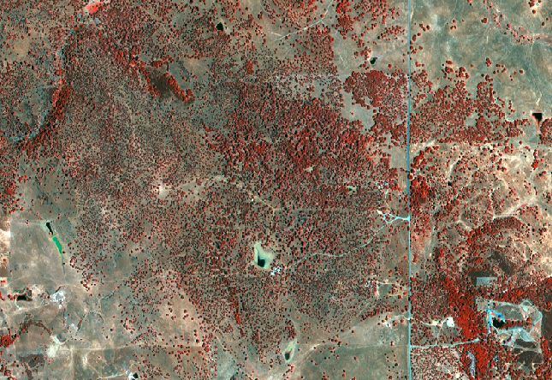
UpScaling Tower Based C Fluxes with Remote Sensing

Slide 56
LIDAR derived map of Tree location and Height

Slide 57
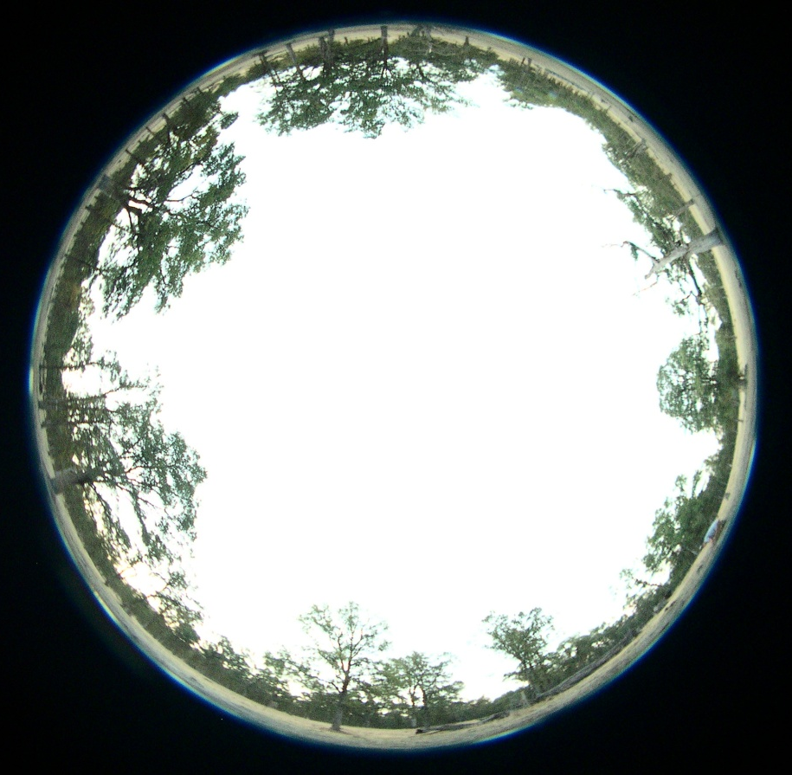
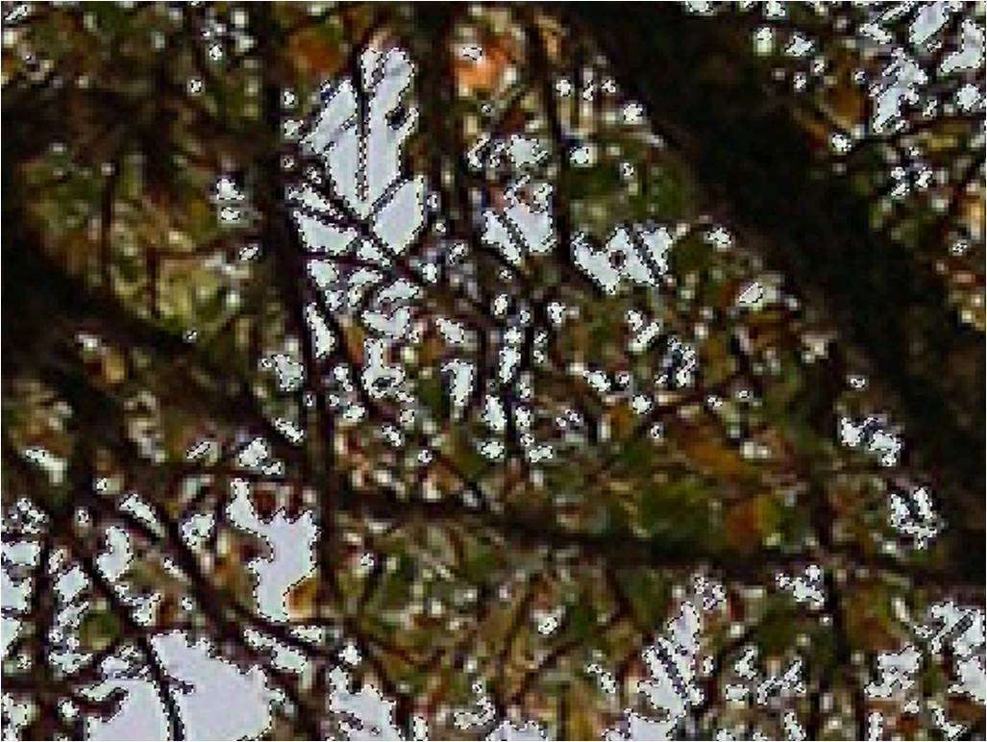
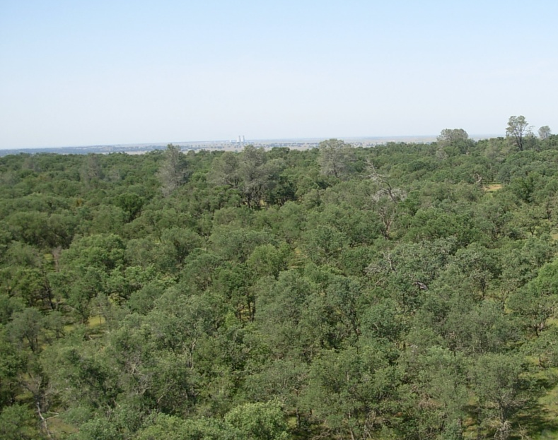
Hemispherical Camera
Upward Looking Camera
Web Camera

Slide 58
Falk, Ma and Baldocchi, unpublished

Slide 59
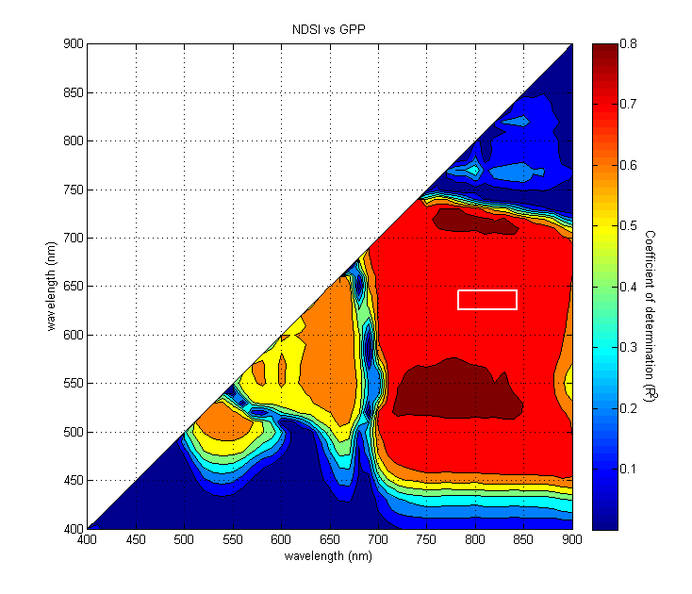
Ground Based, Time Series of Hyper-Spectral Reflectance Measurements,
in Conjunction with Flux Measurements Can be Used to Design Future Satellites

Slide 60
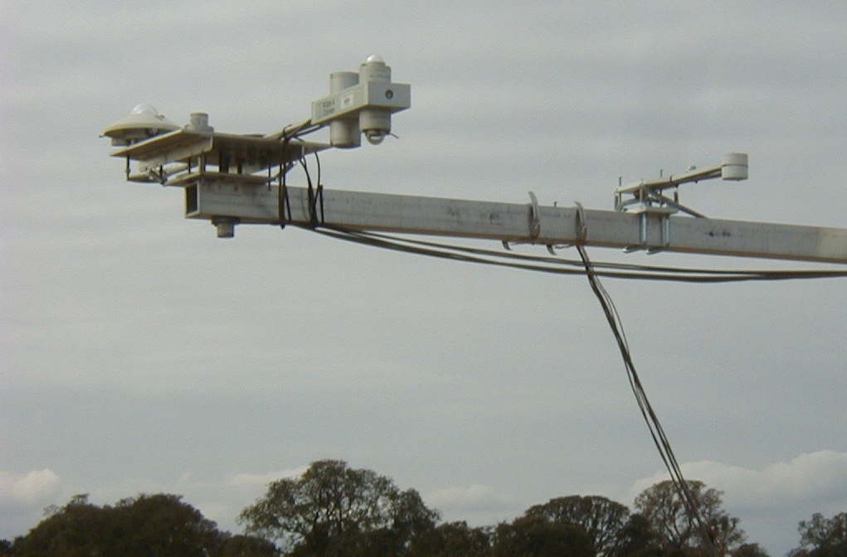
Remote Sensing of NPP:
Up and down PAR, LED, Pyranometer, 4 band Net Radiometer
LED-based sensors are Cheap, Easy to Replicate and
Can be Designed for a Number of Spectral Bands

Slide 61
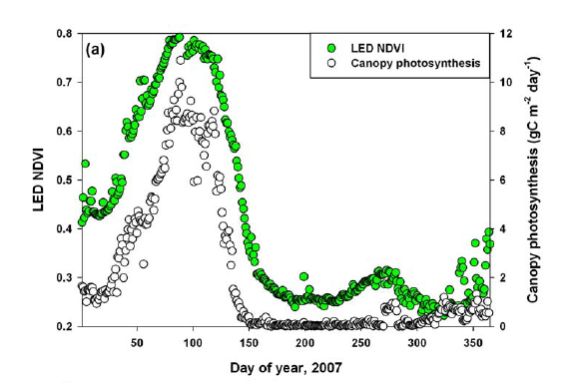
Spectrally-Selective Vegetation Indices Track Seasonality of C Fluxes Well
Ryu et al. Agricultural and Forest Meteorology, in review

Slide 62
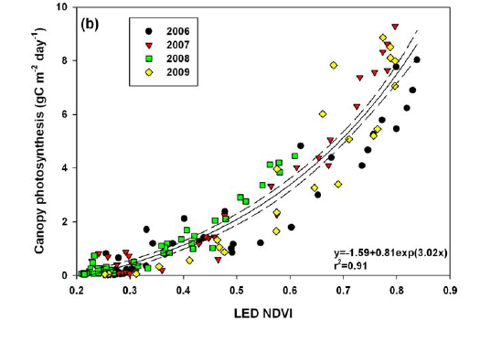
Vegetation Indices can be Used to Predict GPP with Light Use Efficiency Models
Ryu et al. Agricultural and Forest Meteorology, in review

Slide 63
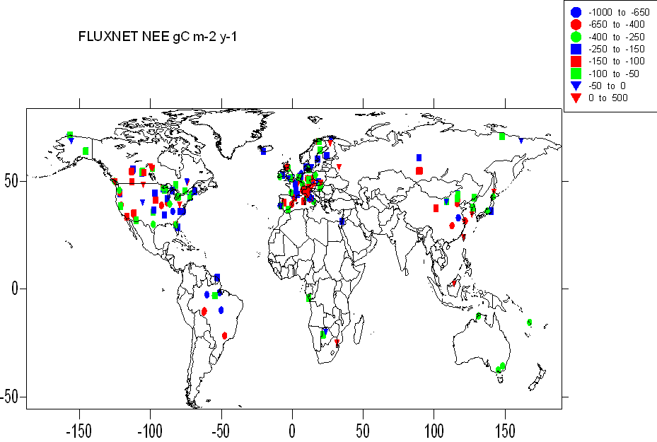
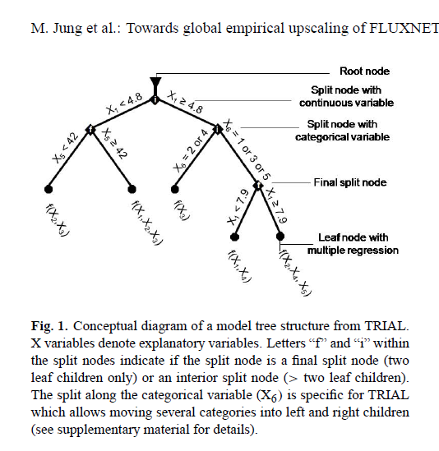
UpScaling of FluxNetworks

Slide 64
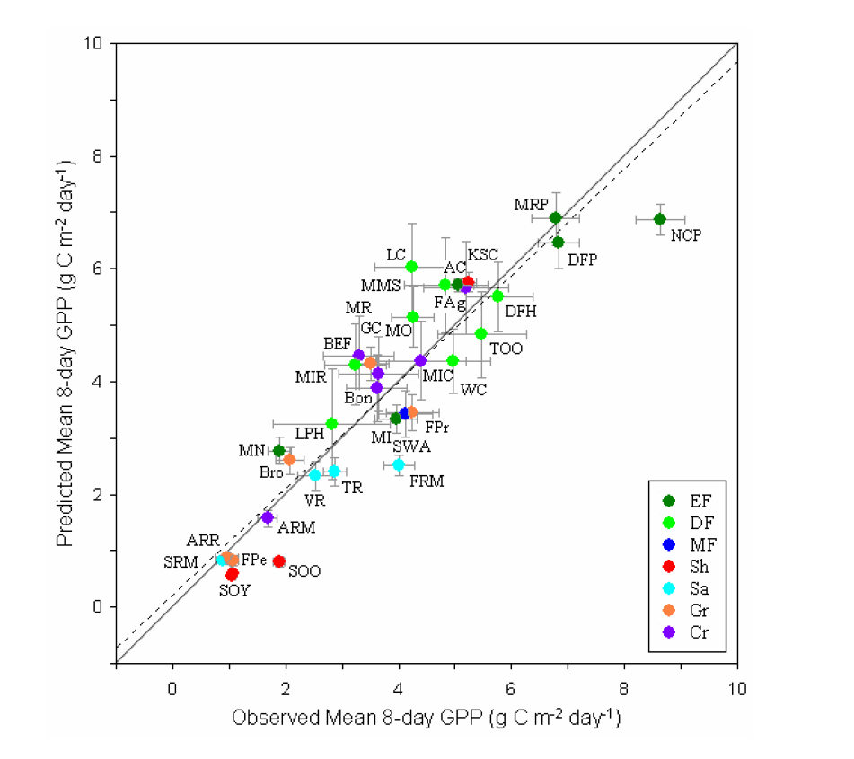
What We can Do:
Is Precision Good Enough for Treaties?
Xiao et al 2010, Global Change Biology

Slide 65
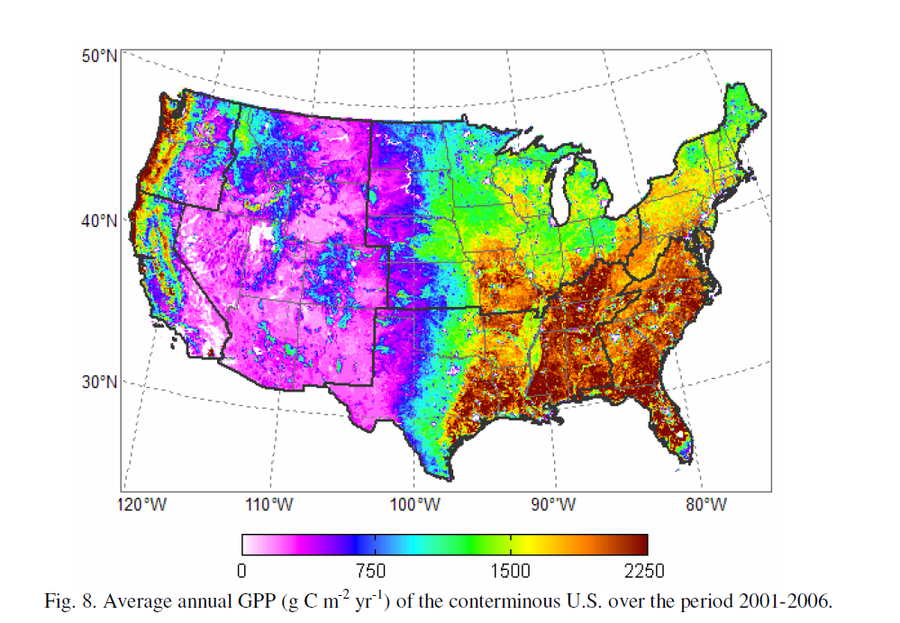
Map of Gross Primary Productivity Derived from Regression Tree Algorithms
Derived from Flux Network, Satellite Remote Sensing and Climate Data
Xiao et al 2010, Global Change Biology

Slide 66
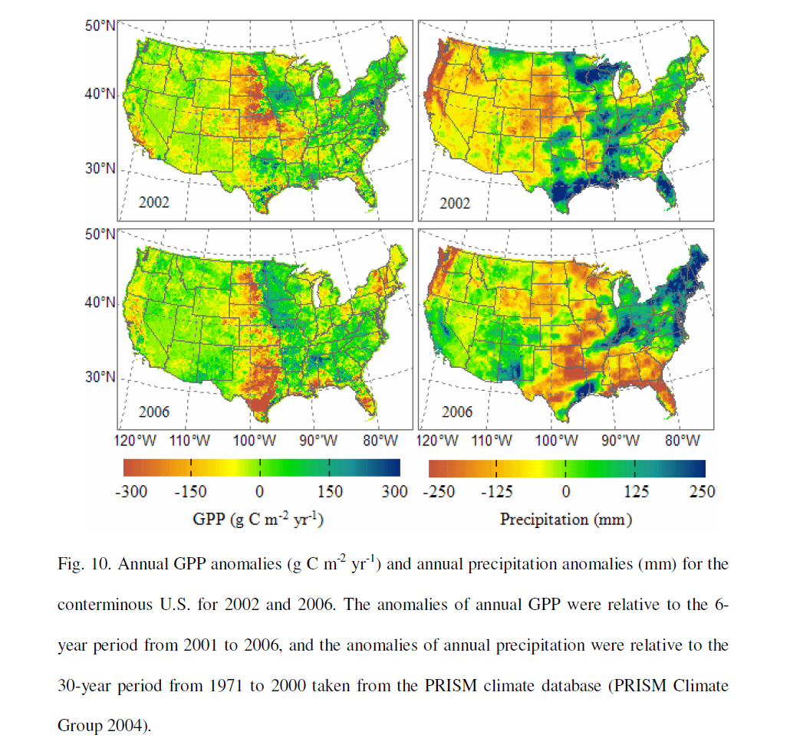
Xiao et al 2010, Global Change Biology

Slide 67
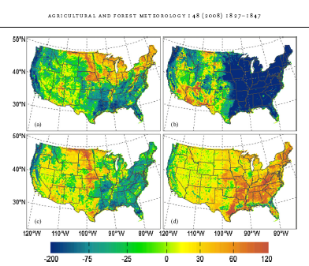
Net Ecosystem C Exchange
spring
summer
autumn
winter
Xiao et al. 2008, AgForMet

Slide 68
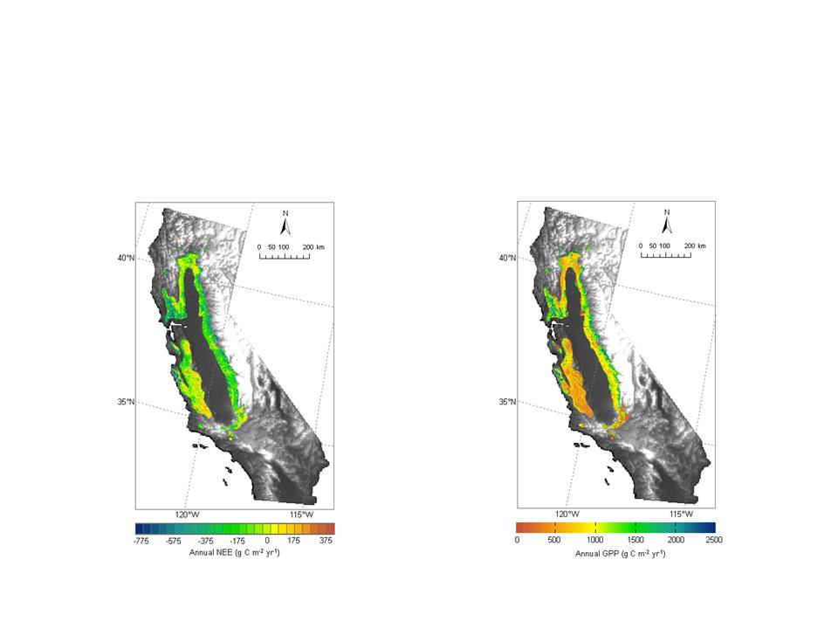
Upscale GPP and NEE to the Biome Scale
area-averaged fluxes of NEE and GPP were -150 and 932 gC m⁻² y⁻¹
net and gross carbon fluxes equal -8.6 and 53.8 TgC y⁻¹
Jingfeng Xiao and D Baldocchi
Notes:
The area-averaged fluxes of NEE and GPP were -150 and 932 gC m⁻² y⁻¹, respectively. And summed up on an areal-basis the net and gross carbon fluxes equal -8.6 and 53.8 TgC y⁻¹, respectively.

Slide 69
Take-Home Message for Application of Eddy Covariance Method under Non-Ideal Conditions
Routine Flux Measurements Must Comply with Governing Principles of Conservation Equation
Design Experiment that measures Flux Divergence and Storage, in addition to Covariance
Networks need more Sites in Tropics and Distinguish C3/C4 crops
Networks need Sites that Cover a Range of Disturbance History
Network of Flux Towers, in conjunction with Remote Sensing, Climate Networks and Machine Learning Algorithms has Potential to Produce Carbon Flux Maps for Carbon Monitoring for Treaty, with Caveats and Accepted Errors

Slide 70
Additional Background Material

Slide 71
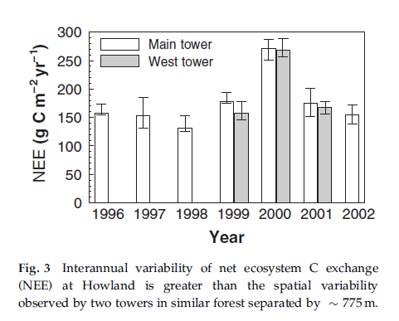
Sampling Error with Two Towers
Hollinger et al GCB, 2004

Slide 72
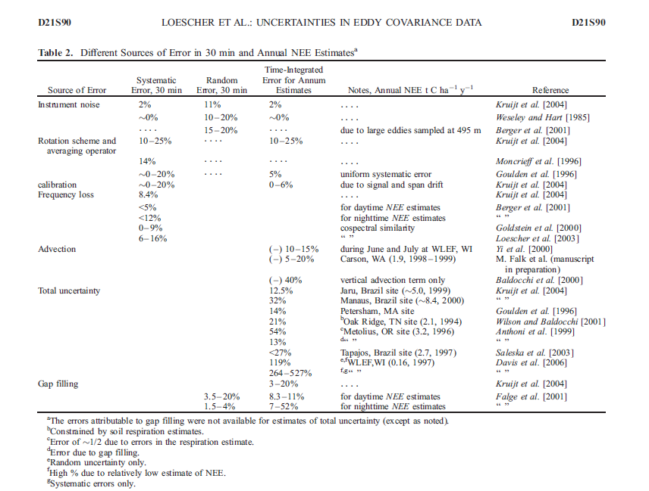

Slide 73
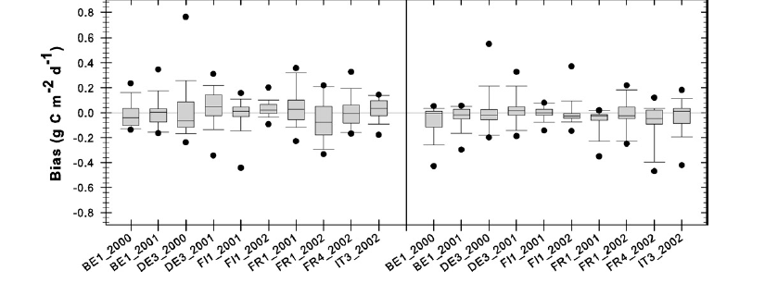
Gap-Filling Inter-comparison Bias Errors
Moffat et al., 2007, AgForMet

Slide 74
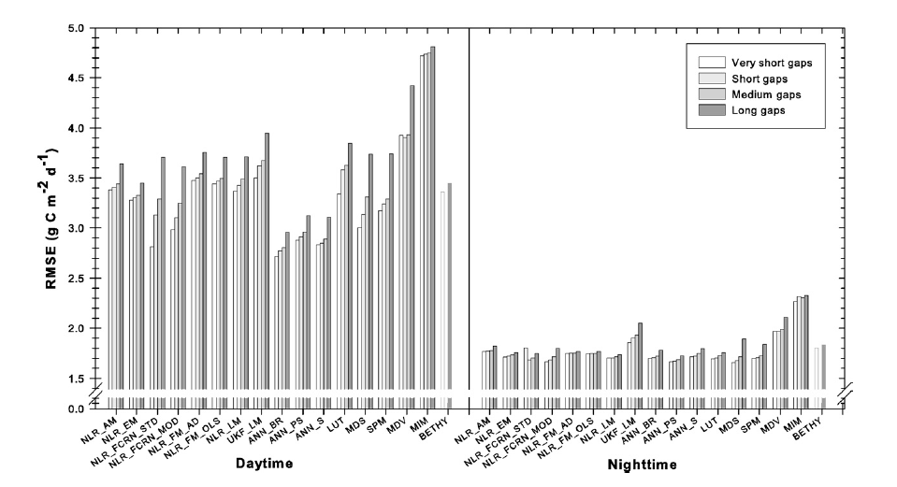
Root Mean Square Errors with Different Gap Filling Methods
Moffat et al., 2007, AgForMet
Notes:
Moffat et al 2007

